Slide 1
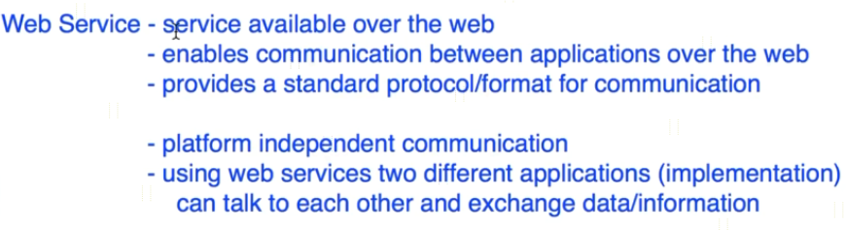
What is a Web Service?

Slide 2


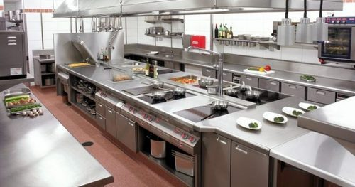
What is a Web Service?
You
Kitchen

Slide 3

What is a Web Service?
Air India
Go Air
Request
Request
Response
Response
Request
Request
Jet Airways
Response
Response
indigo

Slide 4
What is a Web Service?
https://www.udemy.com/course/web-services-api-step-by-step-beginner-tutorial/learn/lecture/10047700?start=0#overview

